Slide 1
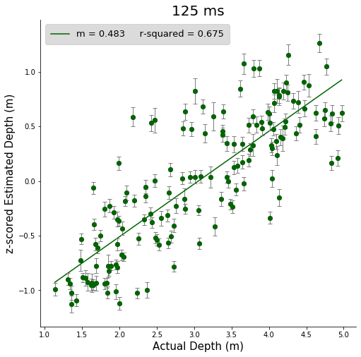
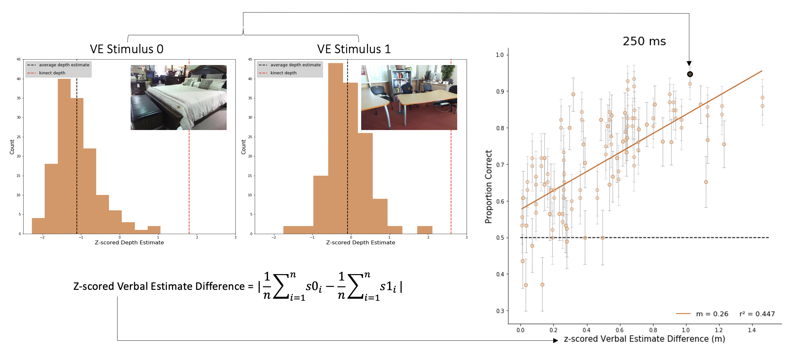
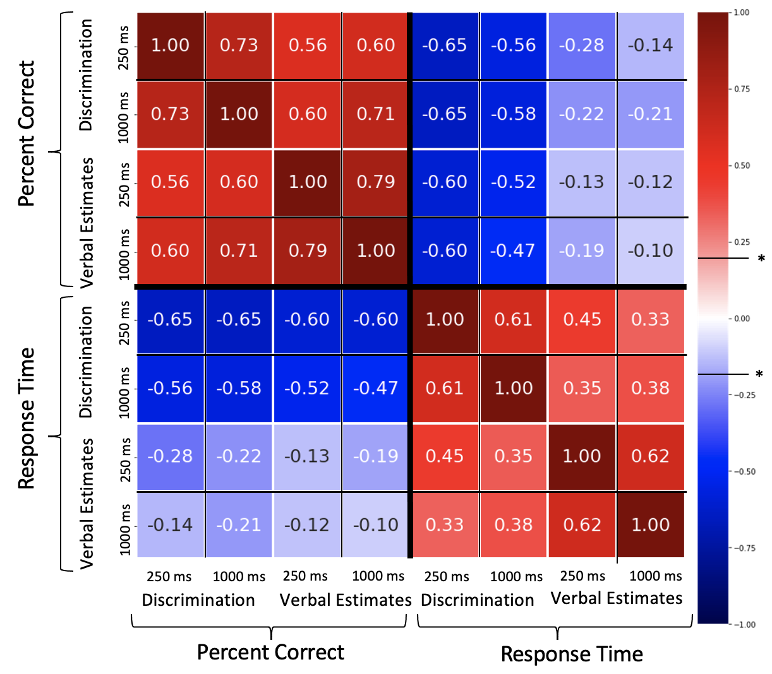
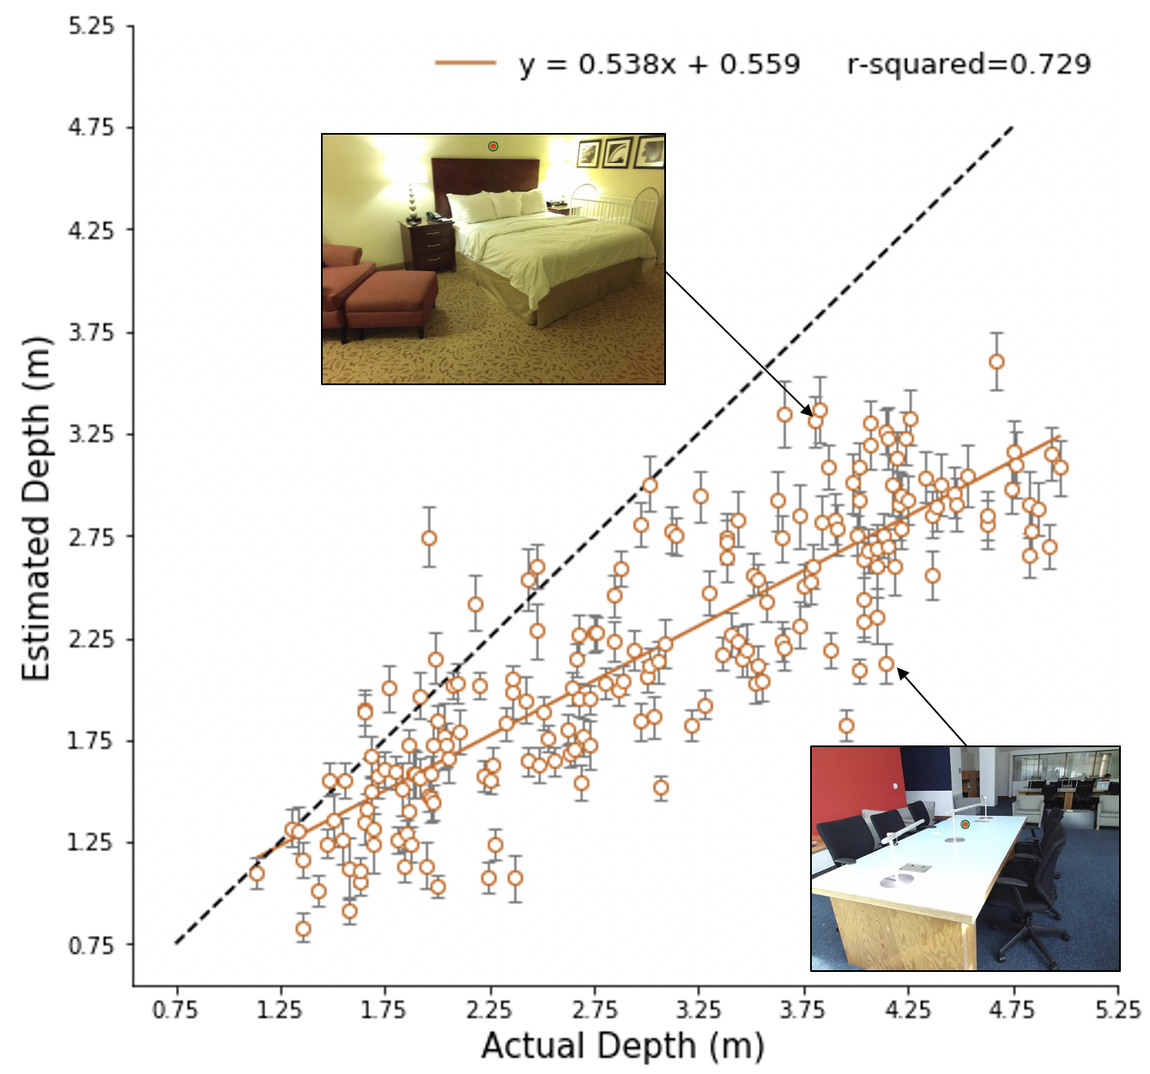
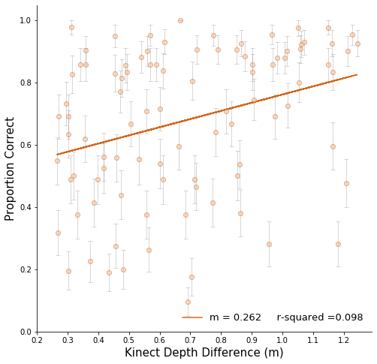
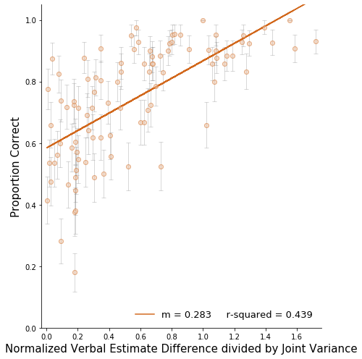
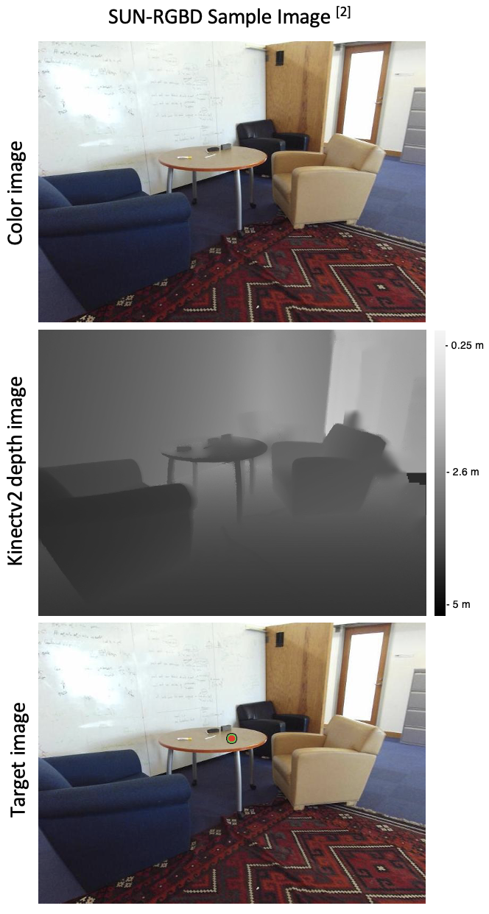
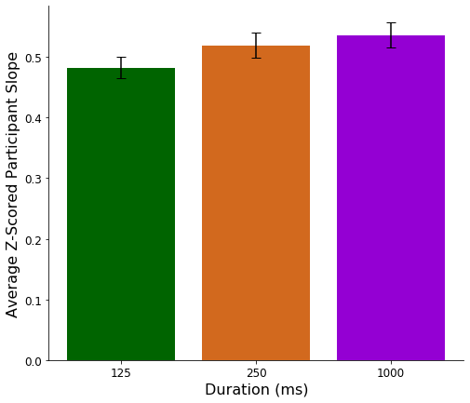
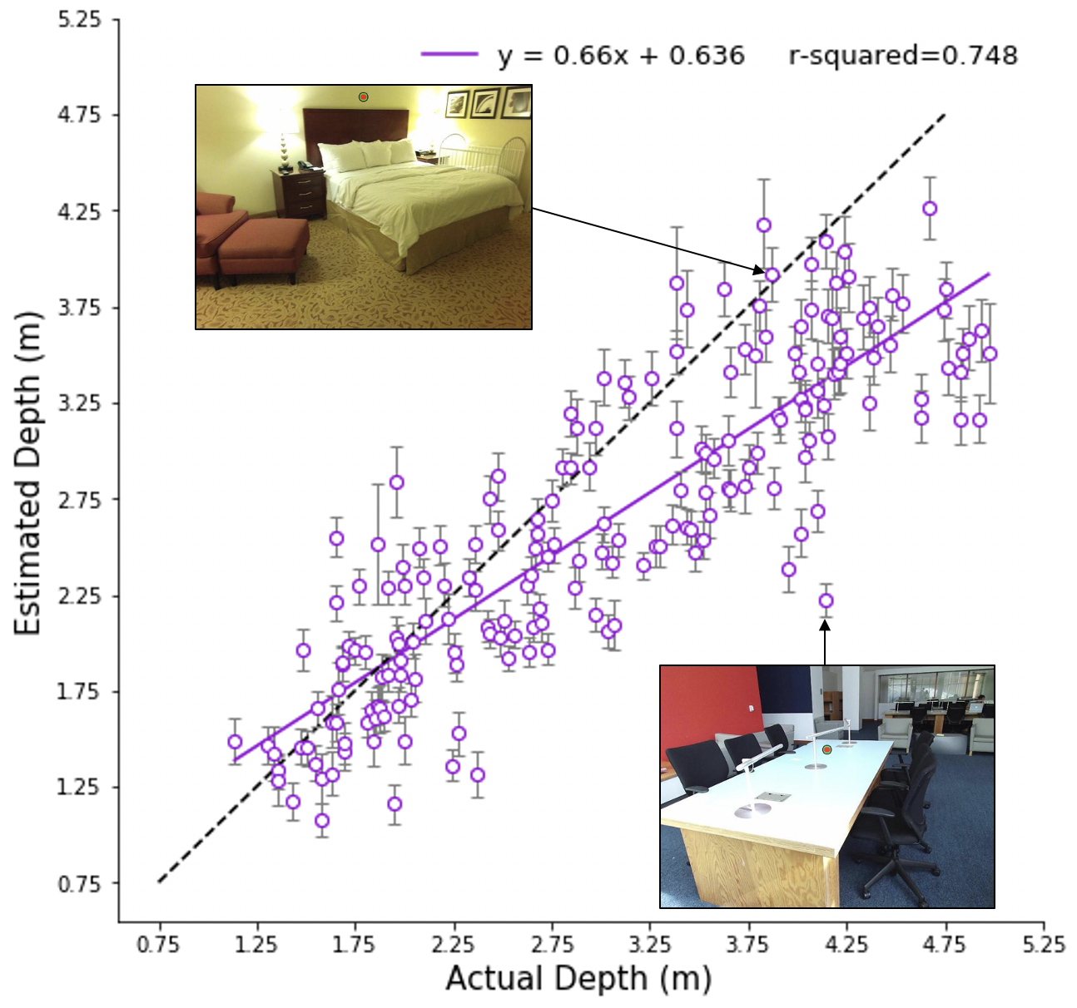
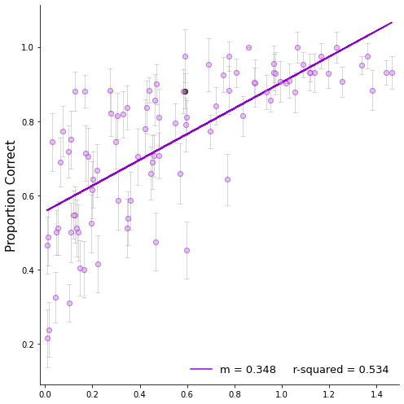
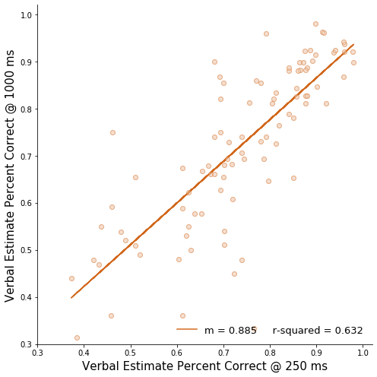
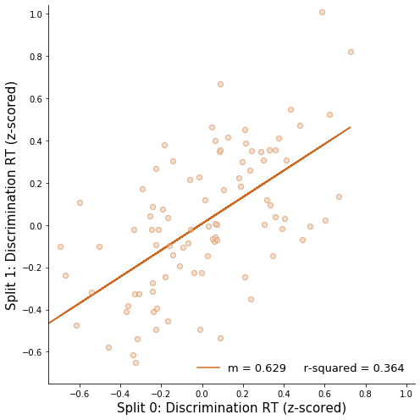
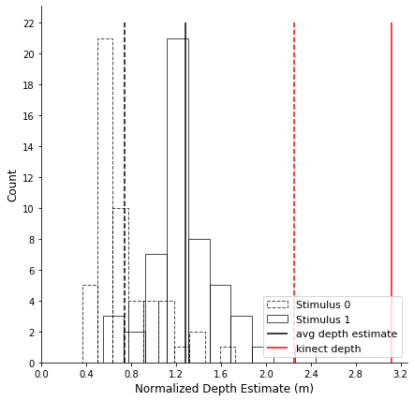
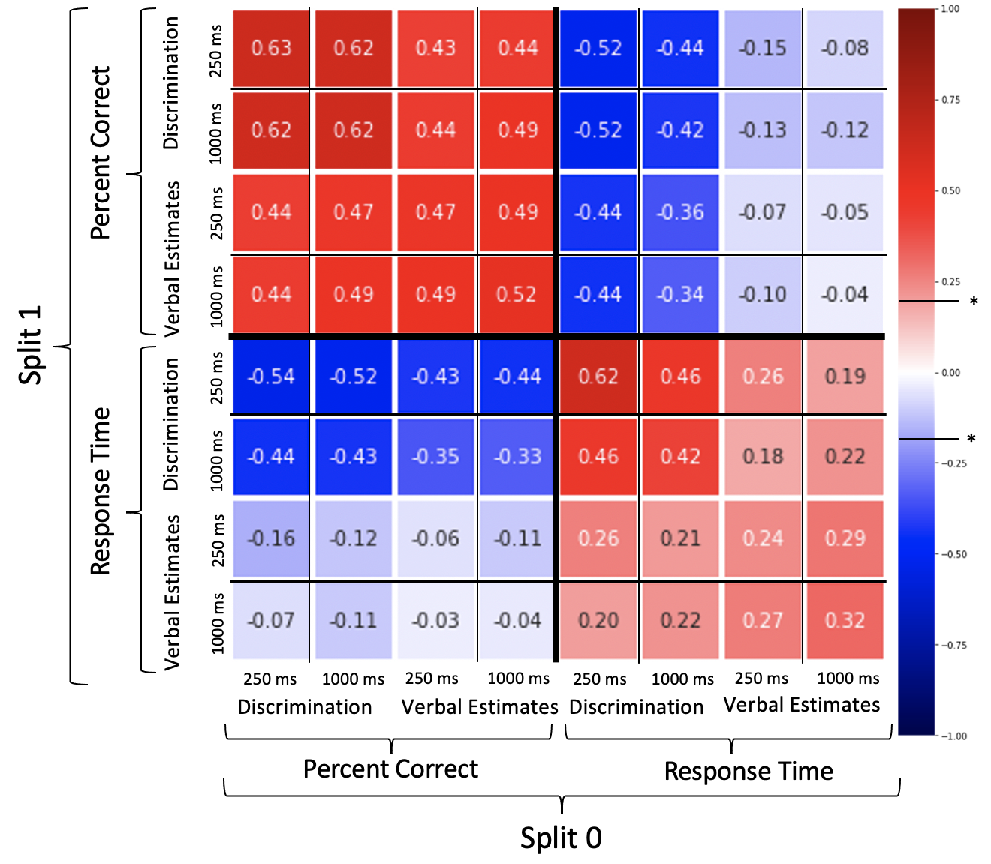

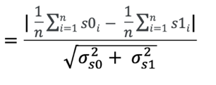
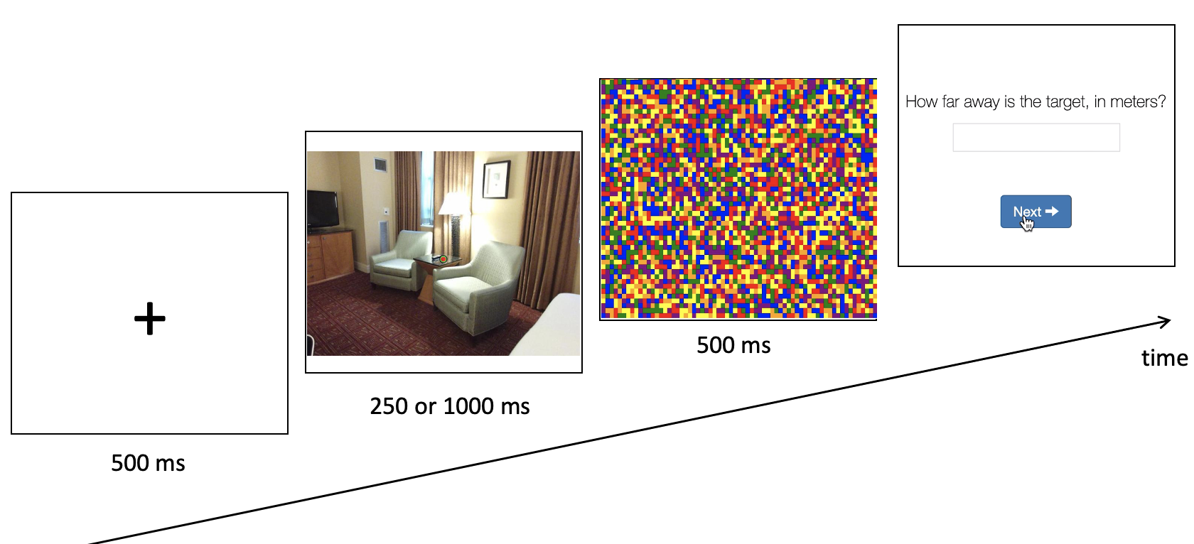
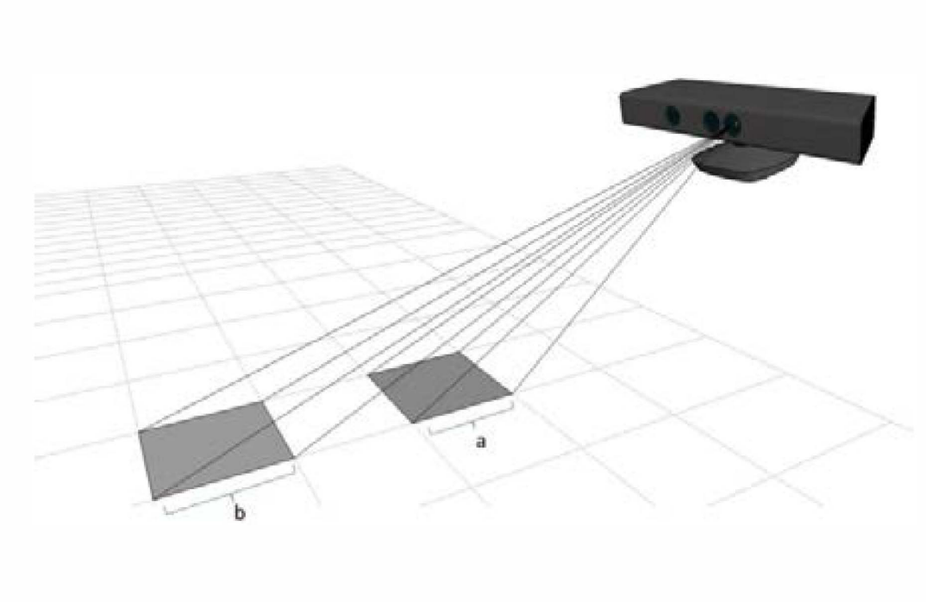
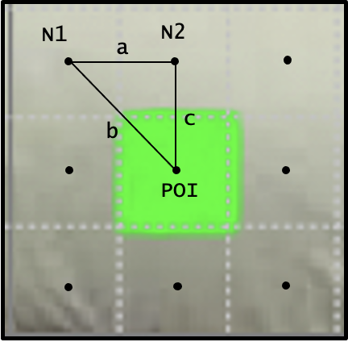
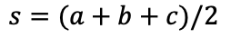
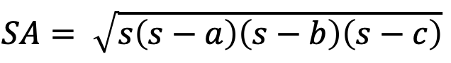
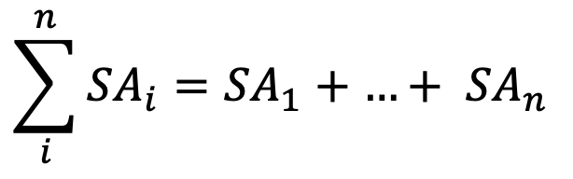
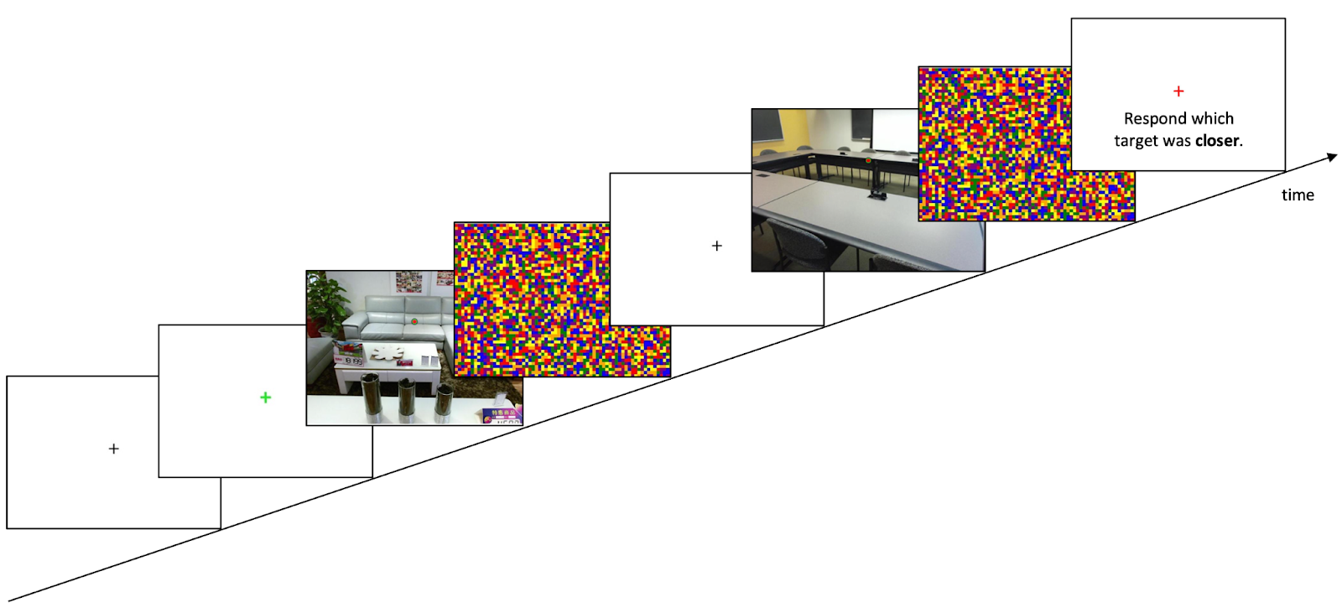
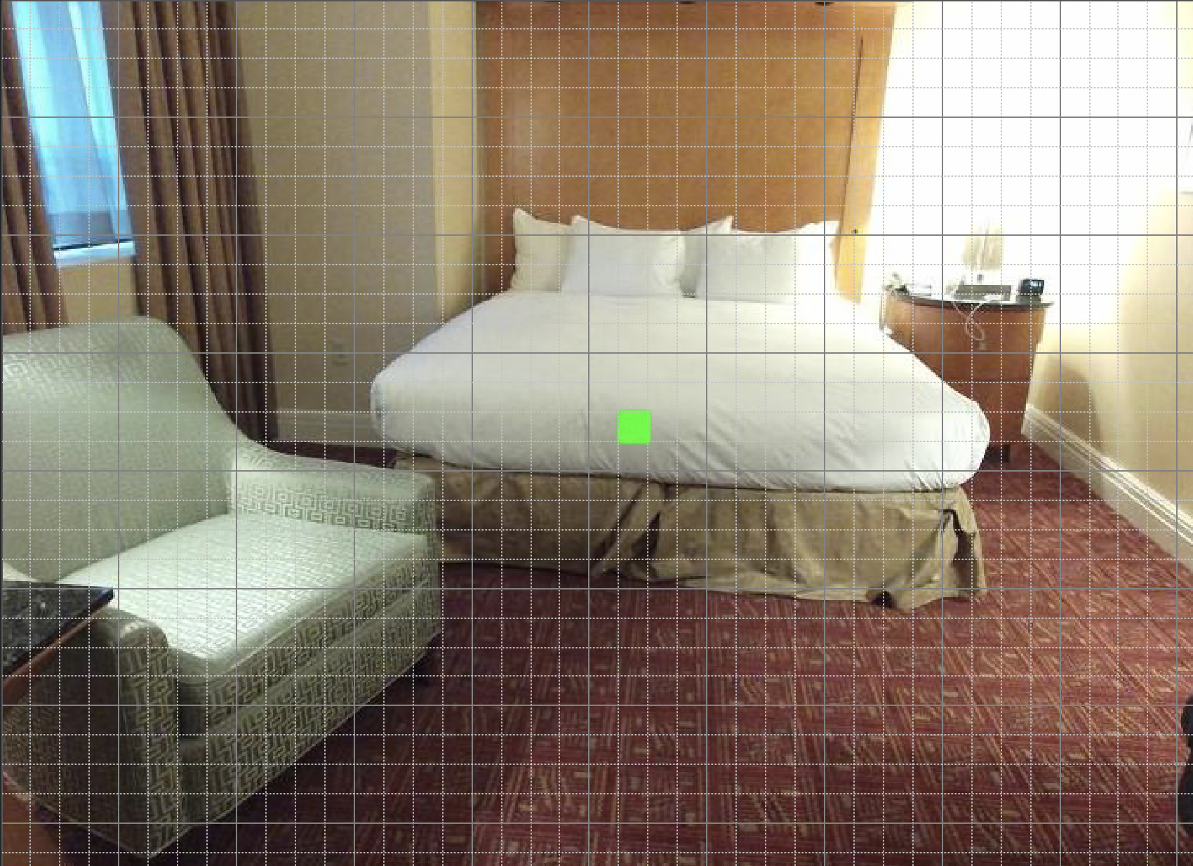
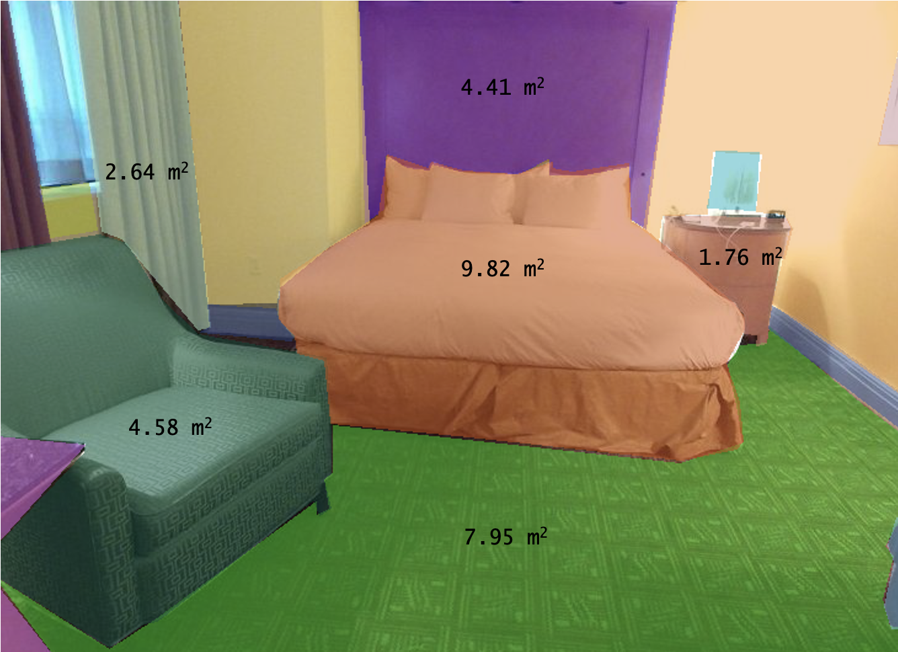
A Novel Generalization between Verbal Judgments and
Perceptual Discrimination of 3D Space
Prachi Mahableshwarkar, Lindsay Houck, John Philbeck, and Dwight Kravitz
Department of Psychological and Brain Sciences, The George Washington University
Introduction
Despite the lack of oculomotor and binocular disparity cues, humans are capable of visual distance perception in pictured scenes. Here we leverage crowd-sourced data collection to model the influence of spatial cues with temporal processing differences.
Results
Stimulus Driven Task Generalization
Verbal Estimate Results
Distance Discrimination Results
We found high reliability in the relationships between tasks, participants, and viewing duration in the complete dataset (top) and after repeatedly splitting the data into independent subsets and evaluating the average correlation matrix (bottom).
Stimuli
Distance estimates to individual scenes showed increasing sensitivity to distance with longer viewing durations (F = 15.32, p < 10^-9)
Discrimination performance was more strongly predicted by signal detection analyses applied to the verbal estimates for the corresponding stimuli in each discrimination (R2 = .57, p < 10^-14) than Kinect tagged depths.
1000 ms Stimulus Duration
Experimental Paradigms
Conclusion
The generalization across tasks and participants suggests a stable and strong relationship between verbal report and discrimination, allowing for the creation of an explicit model that relates stimulus-based visual cues and 3D picture perception. Future work will quantify and model the influence of various visual cues, such as familiar size, on behavioral performance.
Normalized Verbal Estimate Difference divided by Joint Variance
Verbal Judgment (VE) of Distance
Amazon Mechanical Turk, 156 subjects
156 trials, Latin-square counterbalancing
Independent groups of participants
VE @ 250 ms
VE @ 1000 ms
Discrimination @ 250 ms
Discrimination @ 1000 ms
Familiar Size Algorithm
3D Space: (x_{res}, y_{res}, depth)
Pixel Surface Area
Object Surface Area
Distance Discrimination
Amazon Mechanical Turk, 156 subjects
78 trials, Latin-square counterbalancing
Calculating real world object dimensions from Kinect RGB-D image using dynamic resolution. ^{[1]}
Sample Output
References
[1] Anwer, A., Baig, A., & Nawaz, R. (2015). Calculating Real World Object Dimensions from Kinect RGB-D image using dynamic resolution. 2015 12th International Bhurban Conference on Applied Sciences and Technology (IBCAST).
[2] Song, S., Lichtenberg, S. P., &amp; Xiao, J. (2015). Sun RGB-D: A RGB-D scene understanding benchmark suite. 2015 IEEE Conference on Computer Vision and Pattern Recognition (CVPR).
Contact: pmahable@gwmail.gwu.edu
Notes:
Despite lack of monocular cues →
Stimuli → show target embedded picture, and remove text (add citation)
Put paradigms below Stimuli section → remove text
One big analysis section → VE figs (have a line that shows significance between the two stacked)
Make residual 8x8 matrix
Do depth at 250 and depth for 1000 – plotted in the same way
Raw image → show thatit is that pixel → formulae needs to reference something in the images
Future direction → a better stimulus set with more images→ stimulus set is not perfect
Need to include cues in the introduction (humans can do this but HOW?, we want to stable quantification of thebehavior that w can try to predict with image deatures)
METHODS – 4 separate groups pf subjects
Matrix: have an inset (discrim vs VE accuracy)
MEG czichy, aude oliva → make a cascade that goes with the inset
Have one of the diagonals plotted as well (RT)
Include Kinect regression plot
Col2: link tasks together

